Slide 1
Kafka Connect Fundamentals
BUILDING ETL PIPELINES WITH APACHE KAFKA

Slide 2

Big Data
A field that treats ways to deal with data
sets that are too large or
complex to be dealt with by traditional data- processing applications
- Wikipedia

Slide 3
Big Data
A field that treats ways to deal withdata
sets that are too large or
complex to be dealt with by traditional data- processing applications
- Wikipedia
Fast Data
A field that treats ways to deal with streaming data ( data in motion ) by allowing instant
processing as it arrives in the system
- Me

Slide 4

Online newspaper
Batch Oriented -> Real-Time Processing

Slide 5

Apache Kafka
Admin Client
Kafka Producer
Kafka Broker
Kafka Consumer
Kafka Connect
Kafka Streams

Slide 6

ETL with Apache Kafka
Kafka Connect Architecture Building Custom Connectors Kafka Connect in production Prerequisites:
Overview
Apache Kafka
Docker
Java

Slide 7



Extract
ETL
Transform
Load

Slide 8





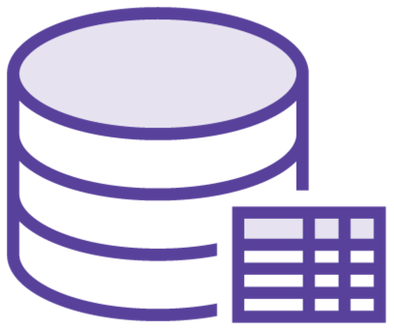

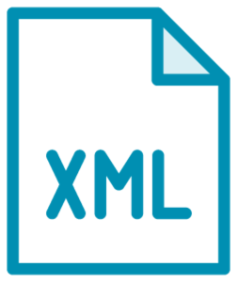





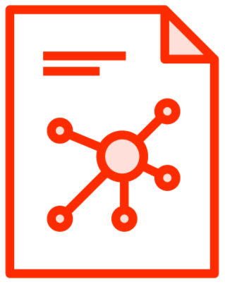

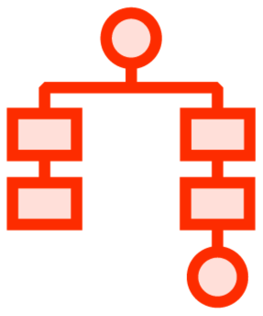



Extract Transform Load

Slide 9
ETL Tools
Apache Airflow
Apache NiFi
Apache Spark
Talend
etc.
Apache Kafka

Slide 10









ETL with Apache Kafka
Apache Kafka
Kafka Streams
Kafka Consumer/Producer
Source
Kafka Connect
Kafka Broker
Kafka Connect
Sink

Slide 11

Kafka Connect
Is NOT an ETL tool by itself! It has some ETL capabilities but it needs to be integrated with some other components from the Apache Kafka Ecosystem.

Slide 12


Apache Spark vs Kafka Connect
Apache Spark
Kafka Connect
Extract
Transform Load Dependencies

Slide 13

Data Flow
Source
Kafka Connect
Kafka Broker
Kafka Connect
Sink

Slide 14


Connectors
Source Connectors
Transfer data from a Source to Kafka
Sink Connectors
Transfer data from Kafka to a Sink

Slide 15
Change Data Capture

Slide 16

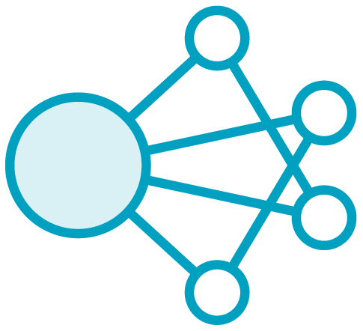
CDC
articles
id author
title
diagram
body
footnote
TX 1: Insert Tom’s article

Slide 17

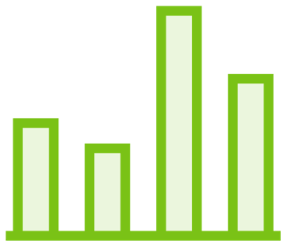
CDC
articles
id author
title
diagram
body
footnote
TX 1: Insert Tom’s article TX 2: Insert Maria’s article

Slide 18
CDC
articles
id author
title
diagram
body
footnote
TX 1: Insert Tom’s article TX 2: Insert Maria’s article
TX 3: Update Tom’s article footnote

Slide 19
CDC
articles
id author
title
diagram
body
footnote
TX 1: Insert Tom’s article TX 2: Insert Maria’s article
TX 3: Update Tom’s article footnote TX 4: Delete Tom’s article

Slide 20
Transaction Logs
MySQL
binlog
PostgreSQL
write-ahead log
MongoDB
op log

Slide 21

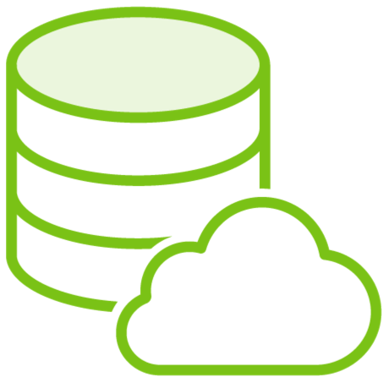


Why CDC?
Live Updates
Replicate
UI
Cloud Database
Update/Invalidate
Feed
Database
Cache
Analytics System

Slide 22







Sharing Data with CDC
Web App
Search Engine
CDC
Messaging System

Slide 23


CDC with Kafka
Kafka Connect
Debezium
Database
Kafka Broker

Slide 24









Debezium
Database
Debezium
Kafka Broker

Slide 25

Demo
Set up Apache Kafka & Kafka Connect
Set up a CDC pipeline using Debezium Source Connector
Prerequisites:
- Docker

Slide 26









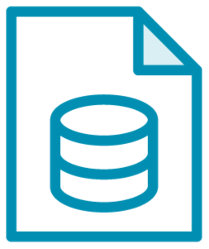


Components
MySQL CLI
Zookeeper
MySQL Server
Kafka Connect
Kafka Broker
Globomantics
Articles
Debezium

Slide 27
Summary
Extract Transform Load
Kafka Connect Change Data Capture

